Slide 1
W04 JavaScript deep dive
Write text here

Slide 2
Program
Recap from the previous module
What is JavaScript
Change how text boxes are formatted
Using JavaScript to hide sections

Slide 3



Recap from the previous module

Slide 4
Preparation
Fundamentals
Syntax & Operators
Usage Examples
Common Mistakes

Slide 5


C/AL != JavaScript

Slide 6


Most frequently used and discussed language

Slide 7
Fundamentals
Case Sensitive
Requires Parentheses
Different Operators
Not Type safe
Curly bracket language like C#
Scripting Language

Slide 8
Case Sensitive & Parentheses
CompanyInformation.Get();
CompanyInformation.CalcFields(‘Picture’);
Customer.First();

Slide 9
Operators
Operator | Description
+ | Addition
- | Subtraction
* | Multiplication
/ | Division
% | Modulus
++ | Increment
-- | Decrement

Slide 10
Assignment Operators
Operator | Example | Same As
= | x = y | x = y
+= | x += y | x = x + y
-= | x -= y | x = x - y
*= | x *= y | x = x * y
/= | x /= y | x = x / y
%= | x %= y | x = x % y

Slide 11
Comparison Operators
Operator | Description
== | equal to
=== | equal value and equal type
!= | not equal
!== | not equal value or not equal type
> | greater than
< | less than
>= | greater than or equal to
<= | less than or equal to
? | ternary operator

Slide 12
Logical & Type Operators
Operator | Description
&& | logical and
|| | logical or
! | logical not
Operator | Description
typeof | Returns the type of a variable
instanceof | Returns true if an object is an instance of an object type

Slide 13
Null vs. Undefined
Undefined means the variable was declared but not set
Null means the variable was explicitly set to empty
var test; // variable declared, but not defined, ... // ... set to value of undefined

Slide 14
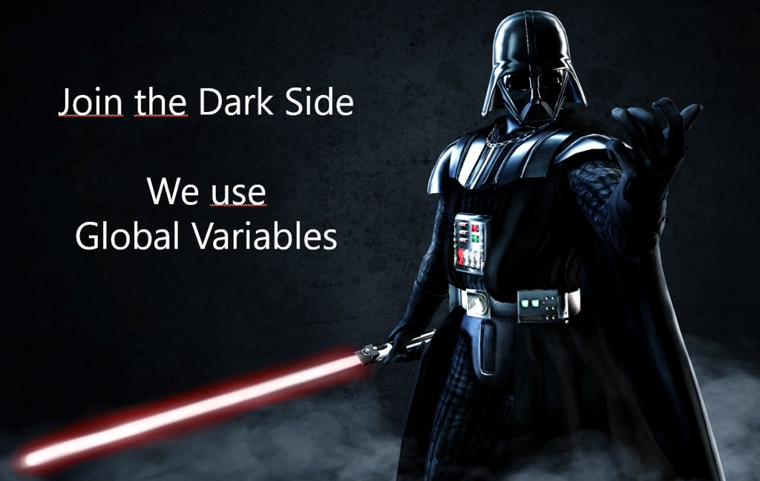
JavaScript in ForNAV
Variables are ALWAYS Global

Slide 15
JavaScript in ForNAV
Source Expressions
Triggers
Show Output
OnPreReport
OnPreDataItem
OnAfterGetRecord
OnPrint

Slide 16
JavaScript order of execution
BC/NAV Action
Requestpage closes
Header Section
Section Triggered
Section ShowOutput JavaScript
ForNAV Action
OnPreReport JavaScript
GroupHeader Section
Show?
No
Yes
OnPreDataItem JavaScript
TransHeader Section
Controls ShowOutput JavaScript
DataItem record is read from the database
Body Section
Show?
No
Yes
OnAfterGet-Record JavaScript
Process Lower DataItem
Controls Source Expression JavaScript
End
TransFooter Section
Controls Formatting
GroupFooter Section
Next Section Triggered
Controls OnPrint JavaScript
Footer Section

Slide 17
Triggers
Read Data
Update Variables
Formatting

Slide 18
ShowOutput
Boolean Expression

Slide 19
Source Expression
Strings

Slide 20
Database Operators
public void Get(params object[] parameters) { record.Get(parameters); }
public void CalcFields(params string[] ExternalFieldNames) { record.CalcFields(ExternalFieldNames); }
public void SetAutoCalcFields(params string[] ExternalFieldNames) { record.SetAutoCalcFields(ExternalFieldNames); }
public void Init() { record.Init(); }
internal bool Next() { return record.Next(); }
internal bool First() { return record.FindFirst(); }
internal void SetFilter(string ExternalFieldName, string Filter) { record.SetFilter(ExternalFieldName, Filter); }
Get();
CalcFields(‘Picture’);
SetAutoCalcFields(‘Balance’);
Init();
Next();
First();
SetFilter(‘Name’, ‘Mark’);
GET;
CALCFIELDS(Picture);
SETAUTOCALCFIELDS(Balance);
INIT;
NEXT;
FINDFIRST;
SETFILTER(Name, ‘Mark’);

Slide 21
Common Mitsakes
This if statement returns false (as expected) because x is not equal to 10:
var x = 0; if (x == 10)
This if statement returns true (maybe not as expected), because 10 is true:
var x = 0; if (x = 10)
This if statement returns false (maybe not as expected), because 0 is false:
var x = 0; if (x = 0)

Slide 22
Expecting Loose Comparison
In regular comparison, data type does not matter. This if statement returns true:
var x = 10; var y = "10"; if (x == y)
In strict comparison, data type does matter. This if statement returns false:
var x = 10; var y = "10"; if (x === y)

Slide 23
var x = 10 + 5; // the result in x is 15 var x = 10 + "5"; // the result in x is "105"
var x = 10; var y = 5; var z = x + y; // the result in z is 15 var x = 10; var y = "5"; var z = x + y; // the result in z is "105"
Because of a misplaced semicolon, this code block will execute regardless of the value of x:
if (x == 19); { // code block }
https://www.w3schools.com/js/js_mistakes.asp

Slide 24
BC/NAV Action
Requestpage closes
Header Section
Section Triggered
Section ShowOutput JavaScript
ForNAV Action
OnPreReport JavaScript
GroupHeader Section
Show?
No
Yes
OnPreDataItem JavaScript
TransHeader Section
Controls ShowOutput JavaScript
DataItem record is read from the database
Body Section
Show?
No
Yes
OnAfterGet-Record JavaScript
Process Lower DataItem
Controls Source Expression JavaScript
End
TransFooter Section
Controls Formatting
GroupFooter Section
Next Section Triggered
Controls OnPrint JavaScript
Footer Section

Slide 25

Change the color of a Text Box based on an expression

Slide 26
Only add the logo and the footer when the invoice is not printed

Slide 27
Use group headers to display a different header for comment lines

Slide 28
Exercise
Make the Invoice total amount red when the amount is over €7000;
Only add the logo and the footer when the invoice is not printed on preprinted paper;
Get the previous invoice no. the customer had and add that to the header;
Use group headers to display a different header for comment lines;
Create a different LineBody for comment lines.

Slide 29
Questions?

Slide 30
Further Learning
Working with JavaScript in the ForNAV designer
https://www.youtube.com/watch?v=4cwbxUq-tc8&t=0s&index=11&list=PLtpjnuA-F0c9bZf3emvhz86-S1uX0a0II
Change colors and fonts dynamically
https://www.fornav.com/knowledge-base/dynamic-control-of-color-and-font-in-text-boxes/

